Slide 1


Project Name - Resume Classification
Team Name
Anil Kumar Rajavarapu
Harsha Vipul Bhatewara
Sahil Rajaram Bachate.
Chakali Kavitha
Pranal Pradeep Chandgude
Suraj Devidas Salunke
Mentor Name
Karthik and Dhanya
Start Date – 28/02/2023
To be filled by Project group-3

Slide 2

Business Problem:
In online recruitment, hiring platforms receive and store an huge amount of resumes and job posts of various fields. Hence, resume classification in database systems is very time consuming and increased human efforts. Also required for lengthy database management system.
Business Objective:
The document classification solution should significantly reduce the manual human effort in the HRM. It should achieve a higher level of accuracy and automation with minimal human intervention.

Slide 3
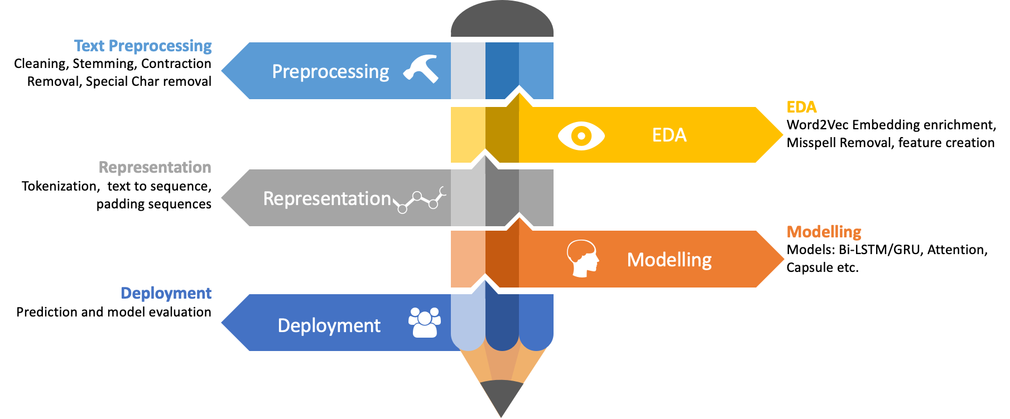
Project Architecture / Project Flow

Slide 4
Imports Libraries
import numpy as np
import numpy as np
import pandas as pd
import matplotlib.pyplot as plt
%matplotlib inline
import os, re
import docx2txt
import textract
import pdfminer
from docx import Document
from tqdm import tqdm
import seaborn as sns
import nltk
from nltk.corpus import stopwords
from nltk.tokenize import sent_tokenize, word_tokenize, RegexpTokenizer
from nltk.sentiment.vader import SentimentIntensityAnalyzer
from nltk.stem import WordNetLemmatizer
from wordcloud import WordCloud
from collections import Counter
from textblob import TextBlob
from textblob.sentiments import NaiveBayesAnalyzer
from textblob.np_extractors import ConllExtractor
from sklearn.feature_extraction.text import CountVectorizer
from sklearn.pipeline import make_pipeline
nltk.download('stopwords')
nltk.download('wordnet')
stopwords = set(stopwords.words("english"))

Slide 5
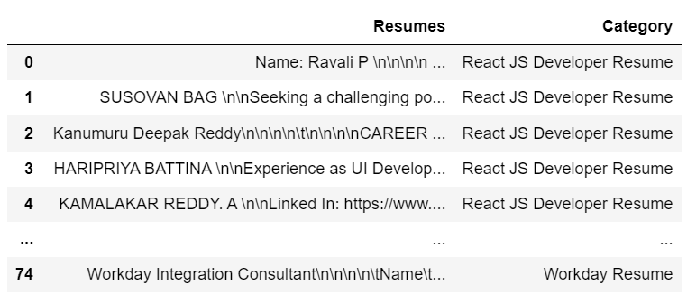
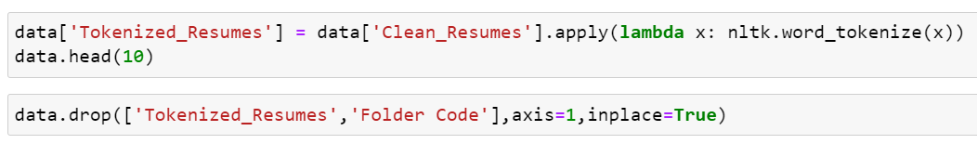
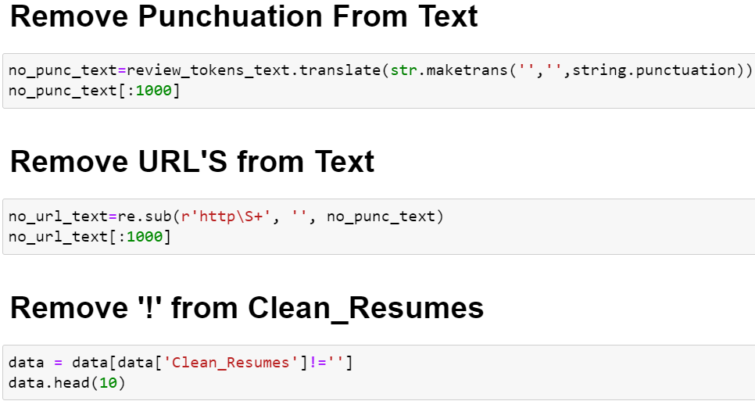
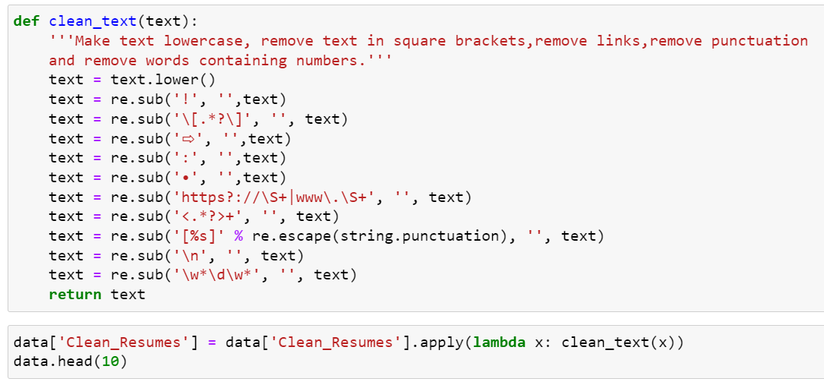
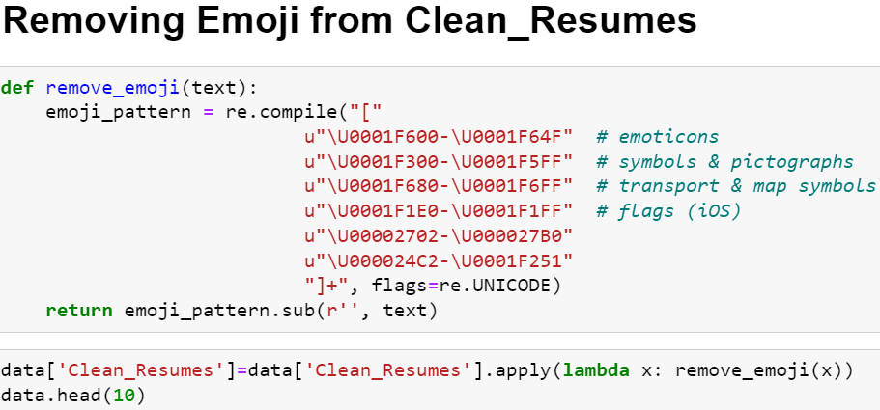
Data Preparation
For text processing, firstly we collected all resumes in one data frame as per their category and save in .csv format.
Text Preprocessing
Tokenization
Tokenization is used in natural language processing to split paragraphs and sentences into smaller units that can be more easily assigned meaning.
Lower casing

Slide 6
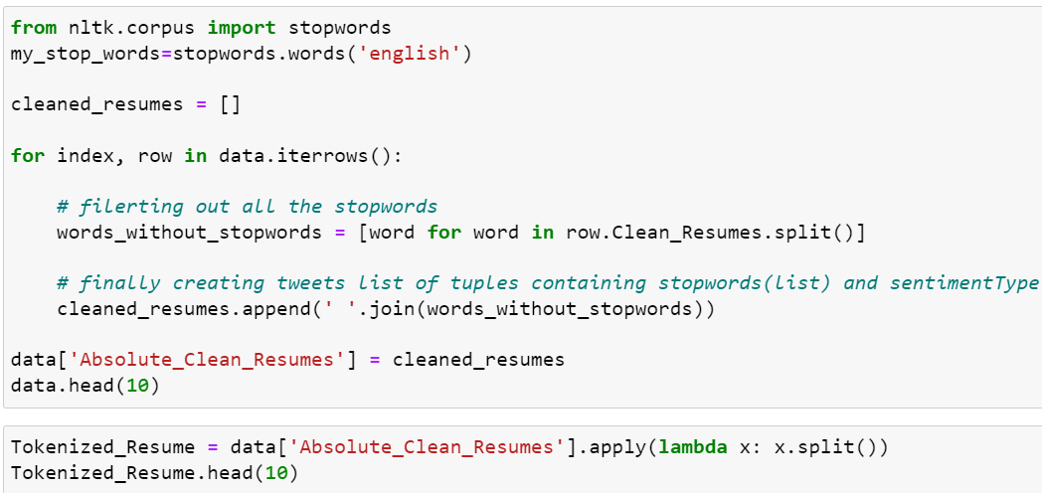
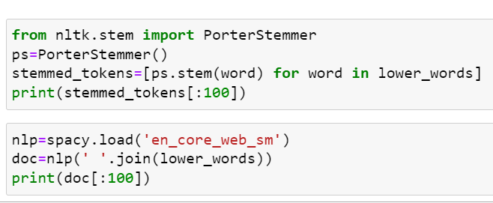
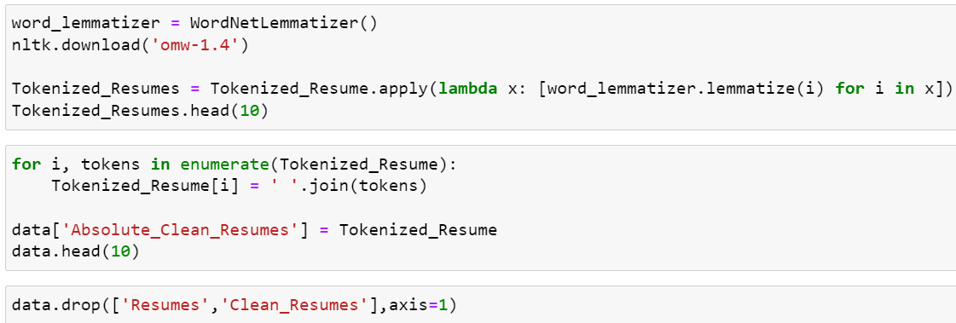
Stop words removal
Stop words are a set of commonly used words in any language. stop words are used to eliminate unimportant words, allowing applications to focus on the important words instead.
Stemming
Stemming is the process of reducing a word to its stem that affixes to suffixes and prefixes or to the roots of words known as "lemmas"
Lemmatization
It is a text normalization technique used in NLP, that switches any kind of a word to its base root mode. It is responsible for grouping different inflected forms of words into the root form, having the same meaning.

Slide 7
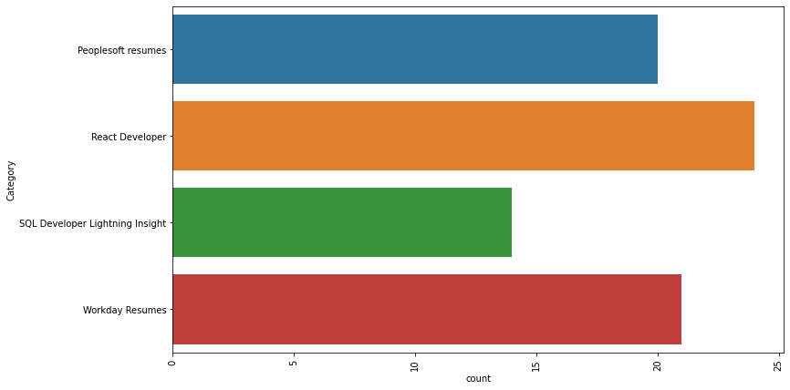
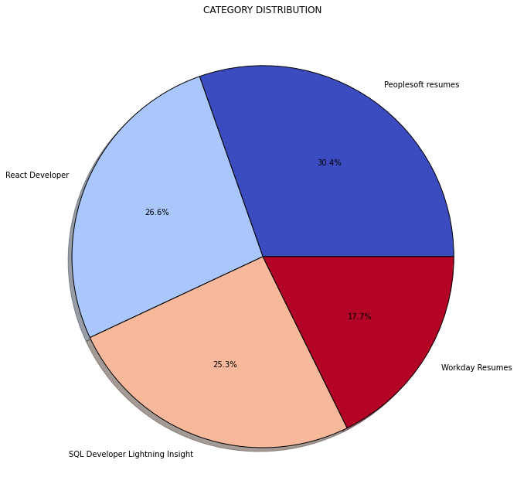
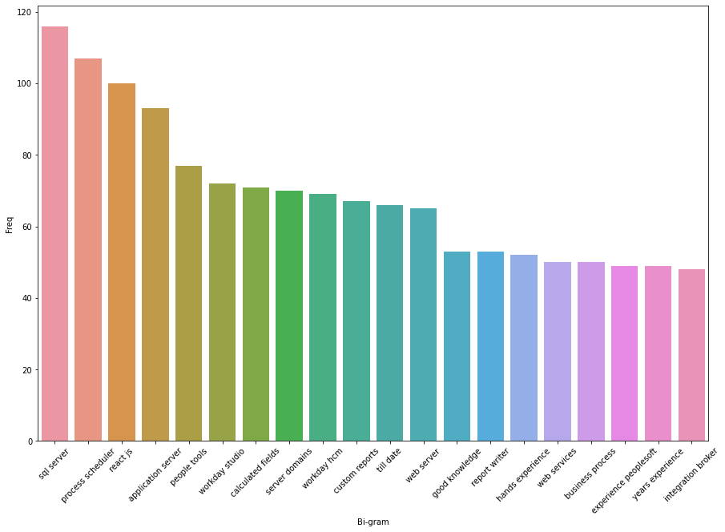
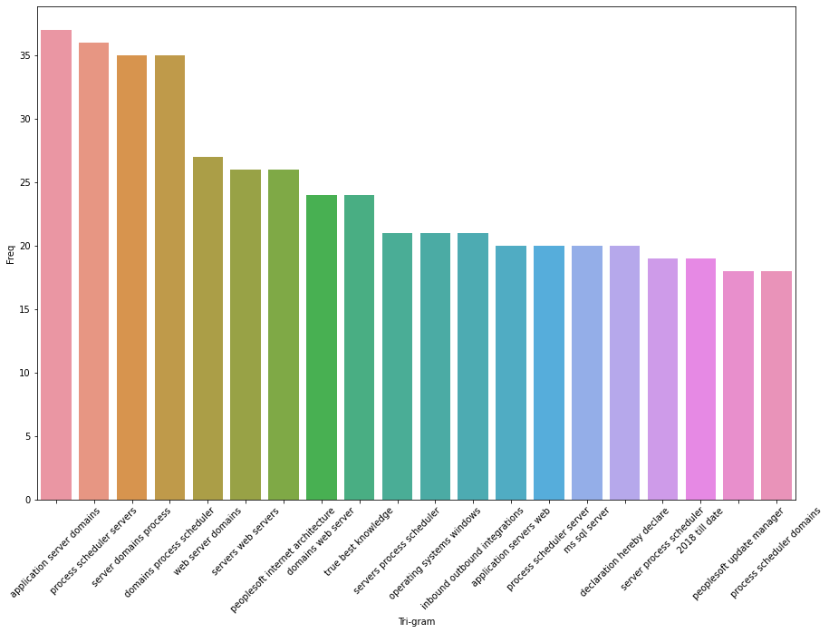
Exploratory Data Analysis (EDA)
Graph of Top 20 Bi-gram words
Graph of Top 20 Tri-gram words

Slide 8
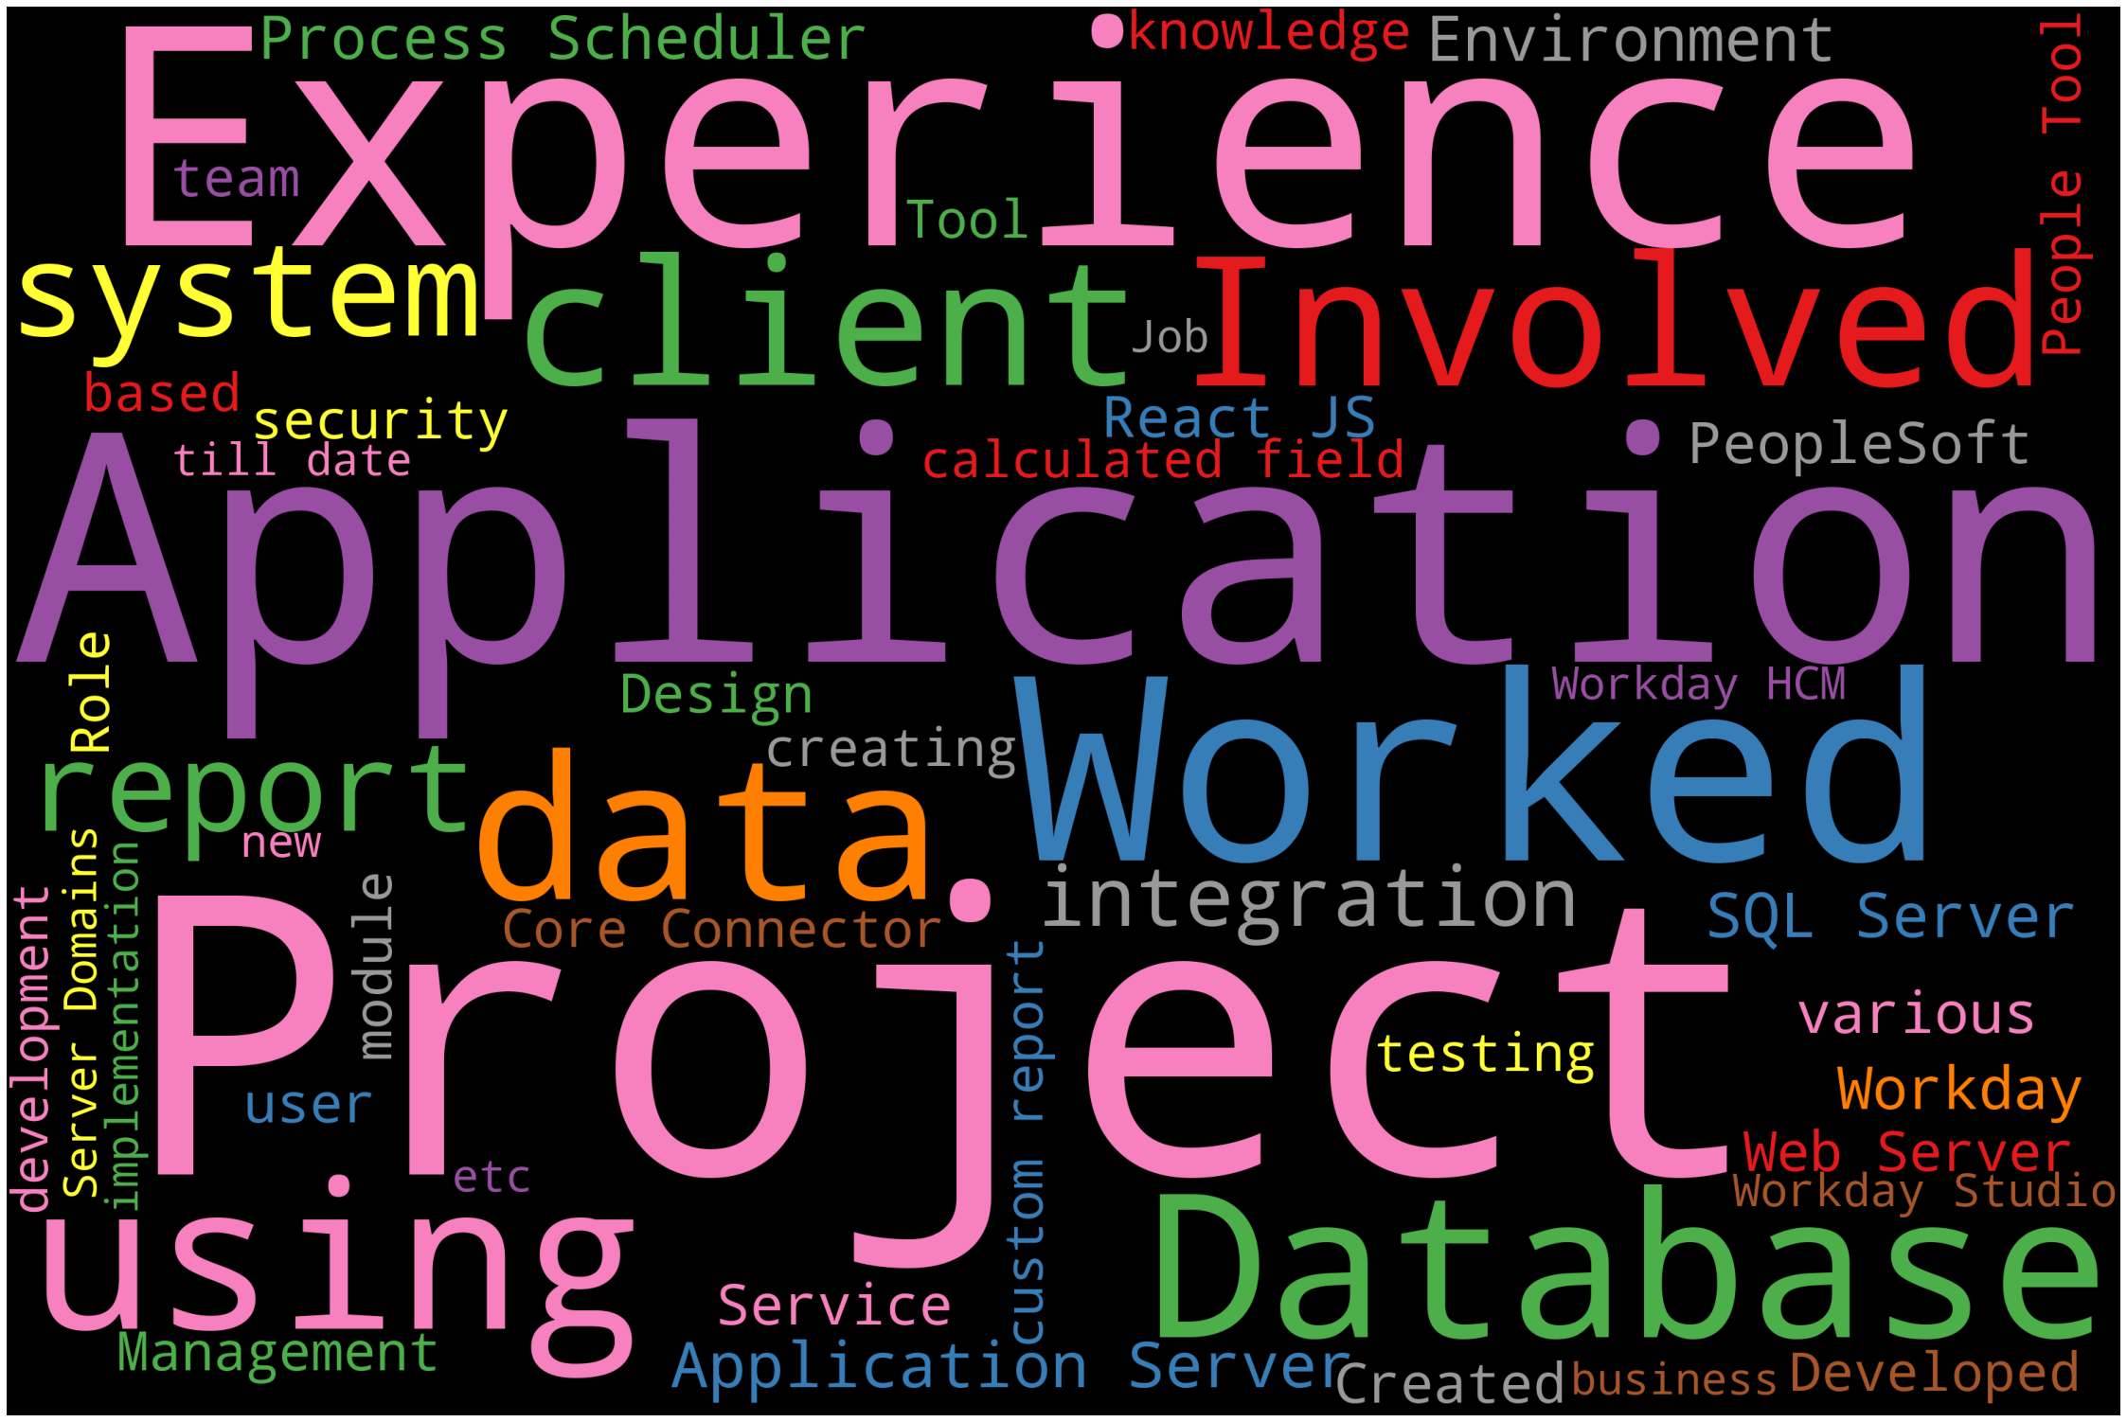
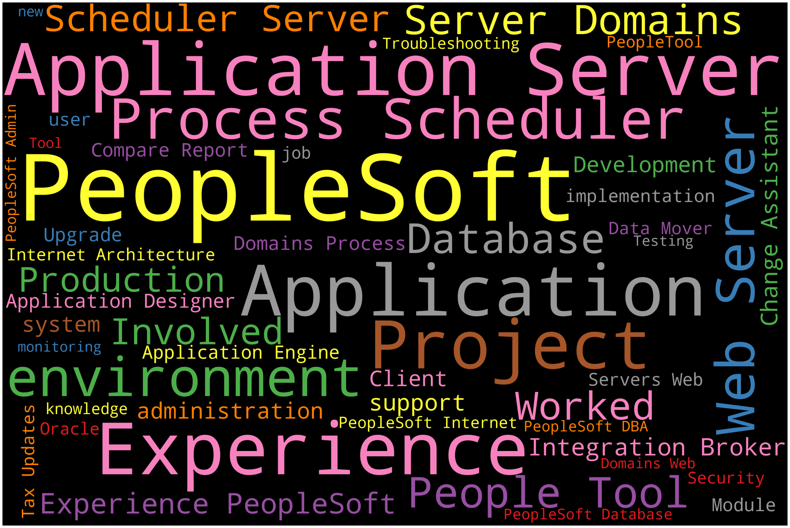
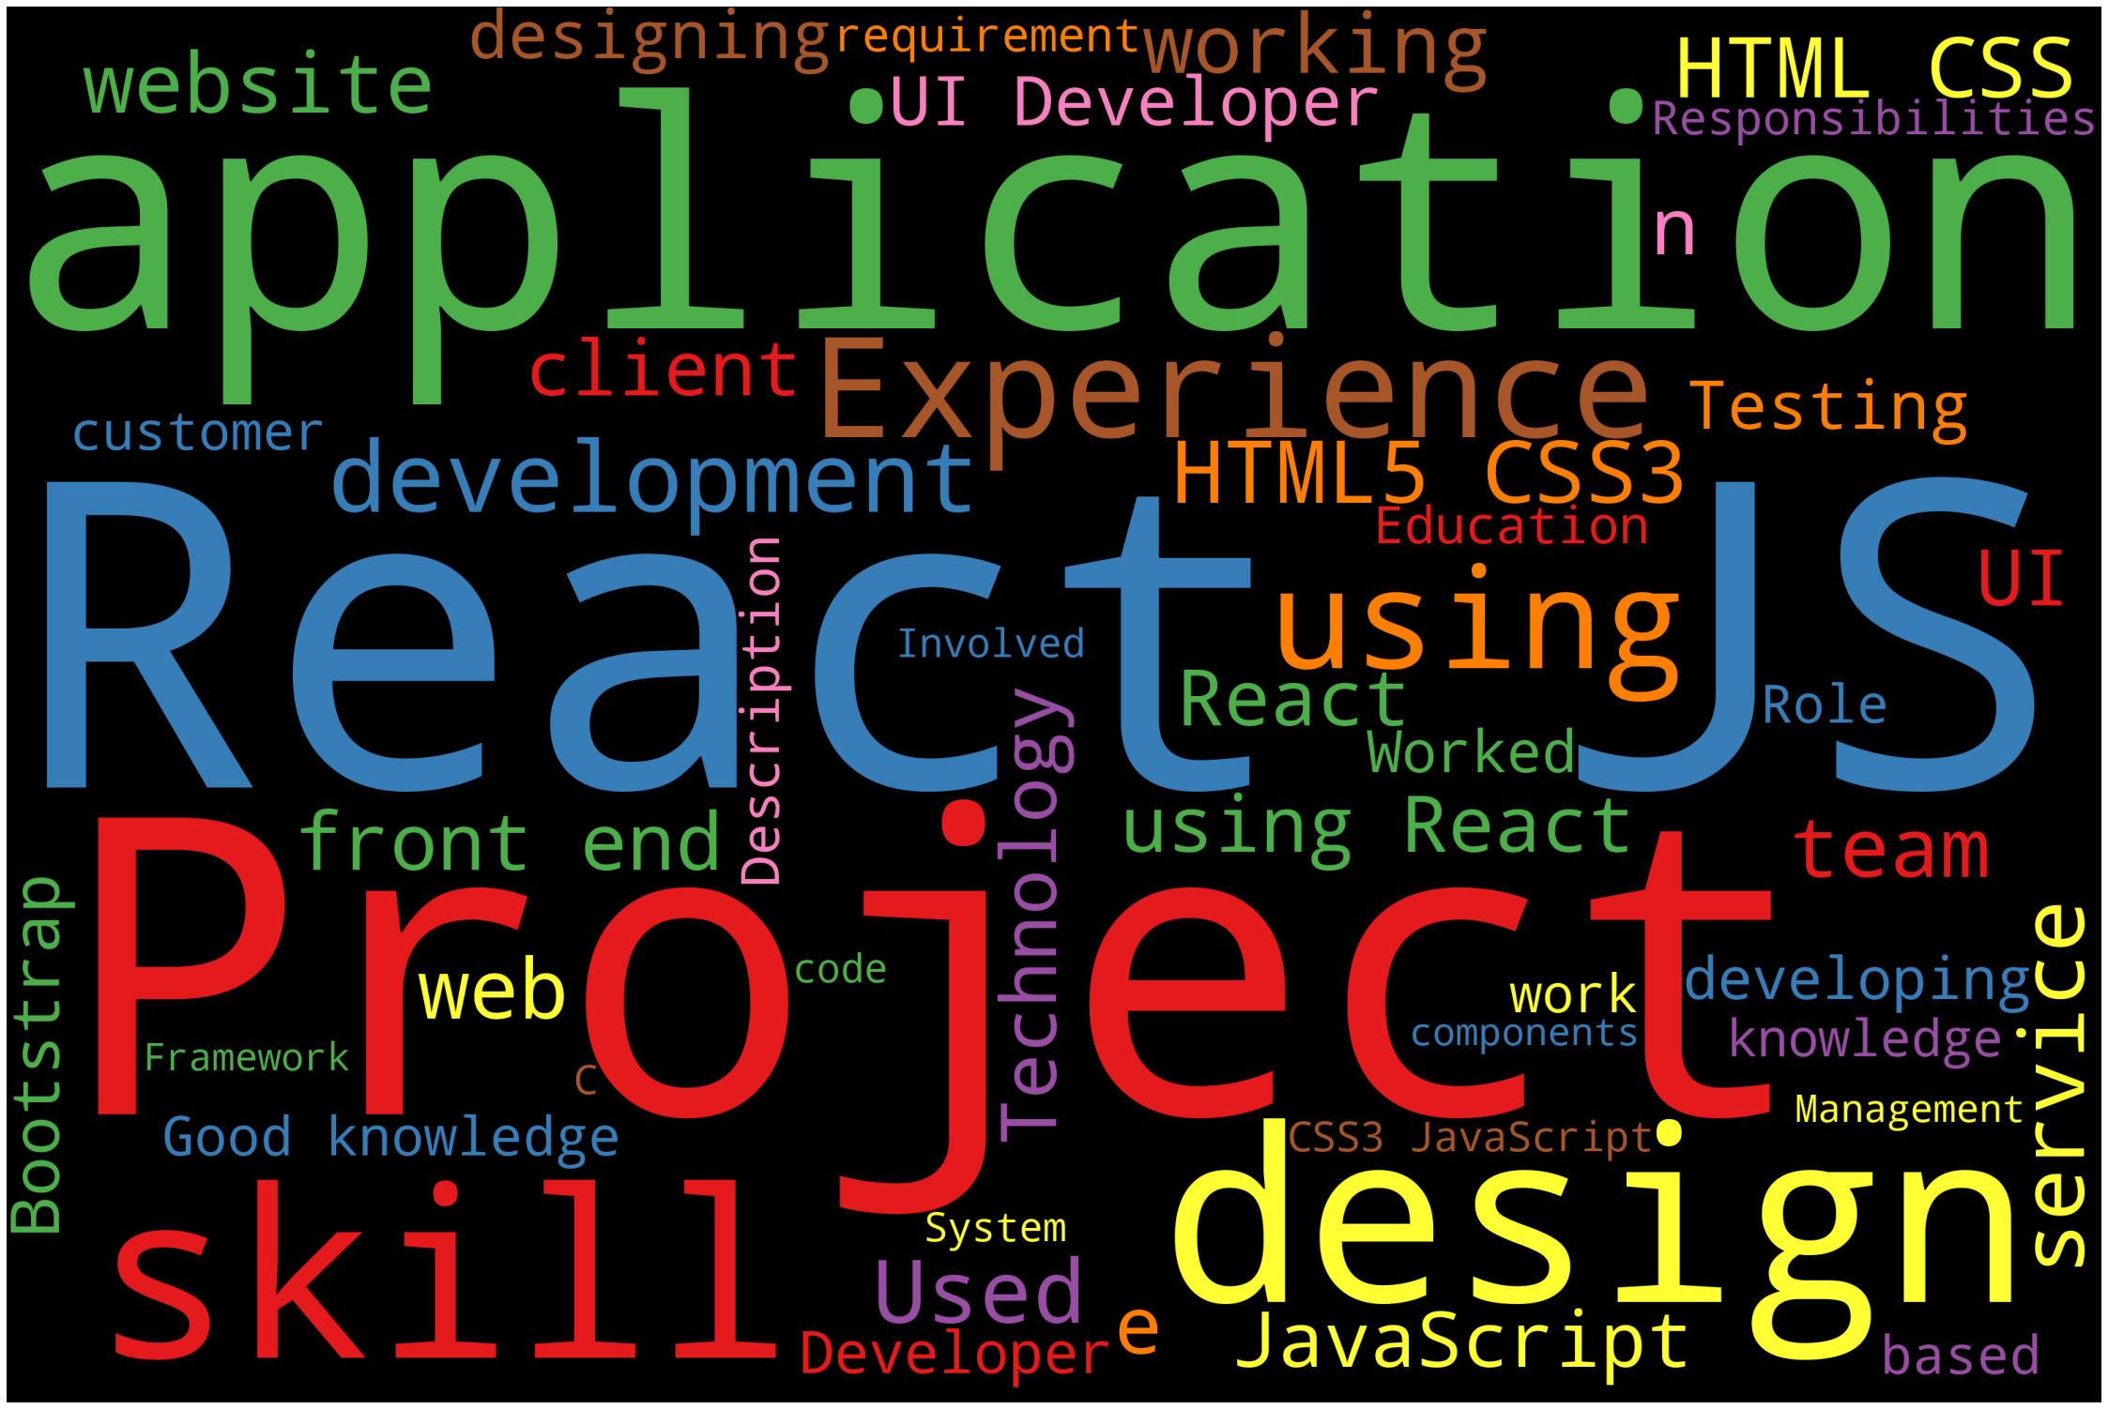
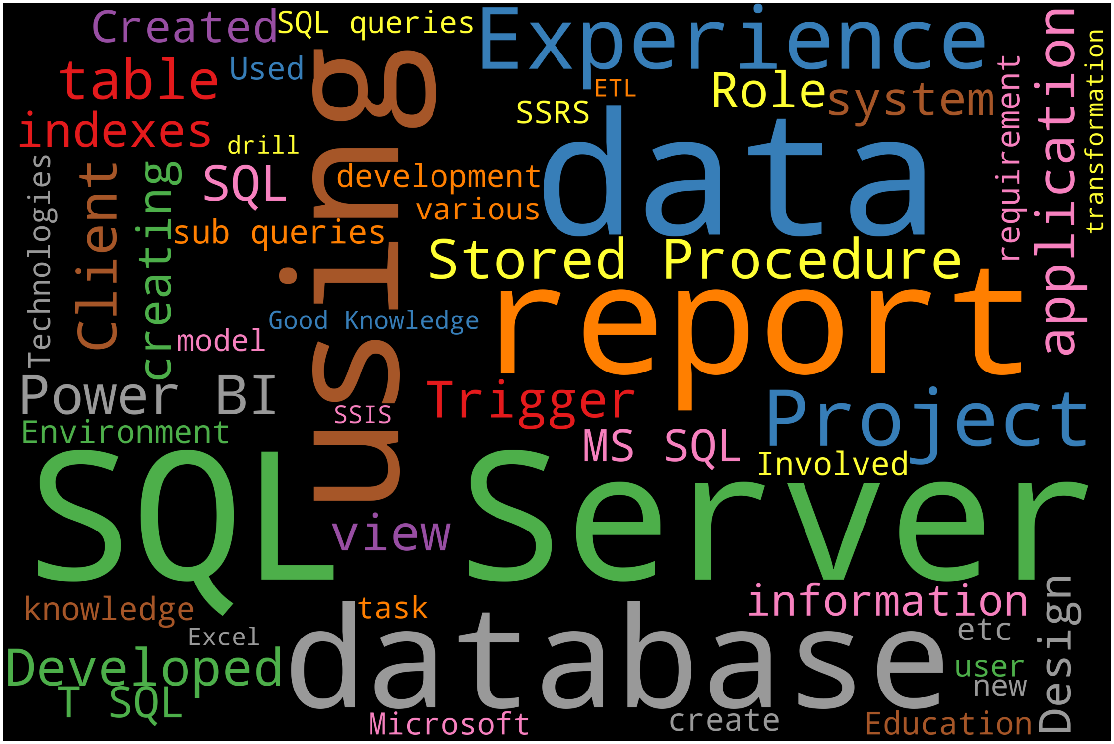
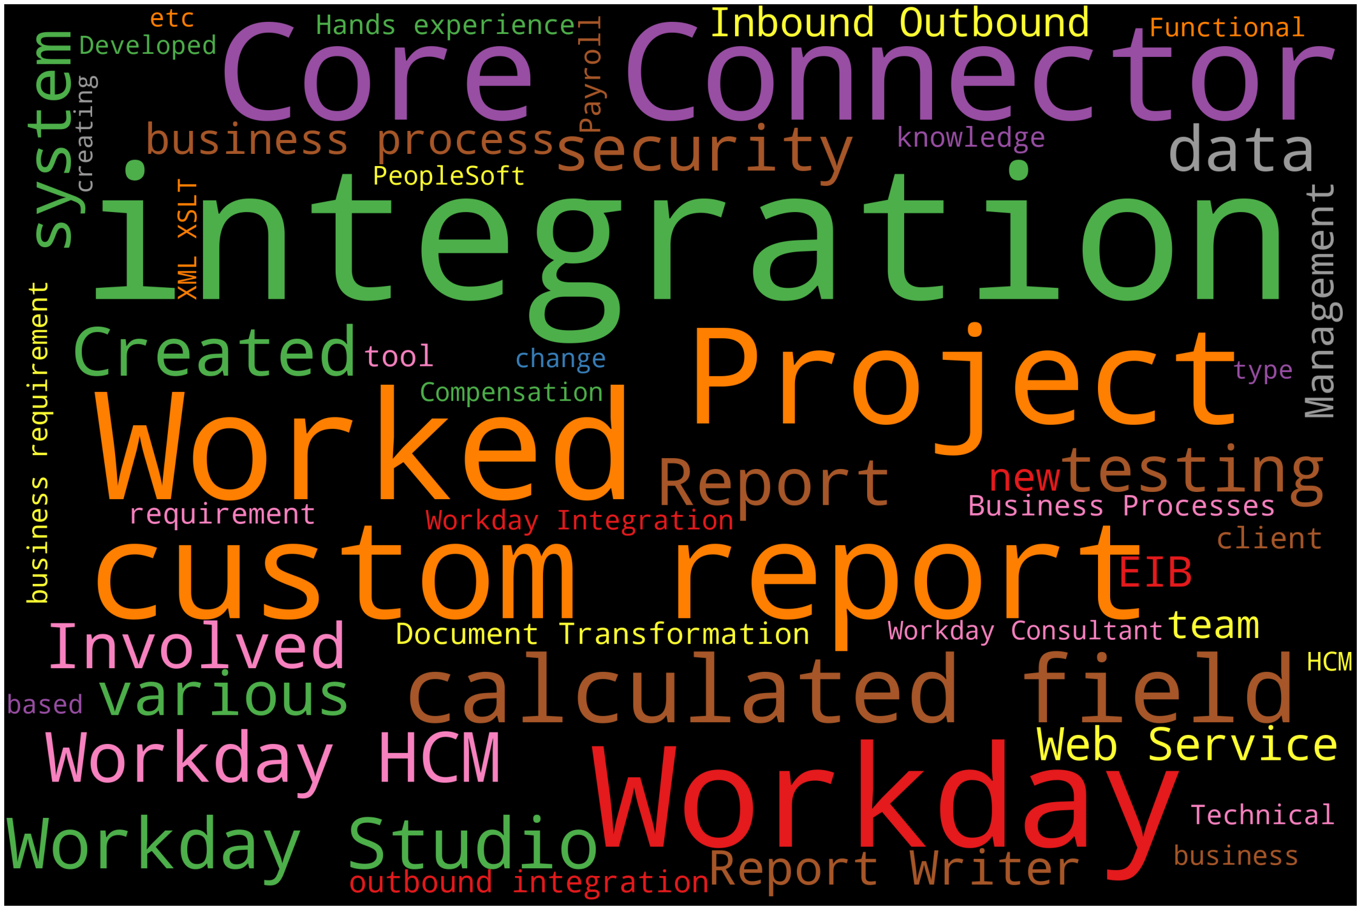
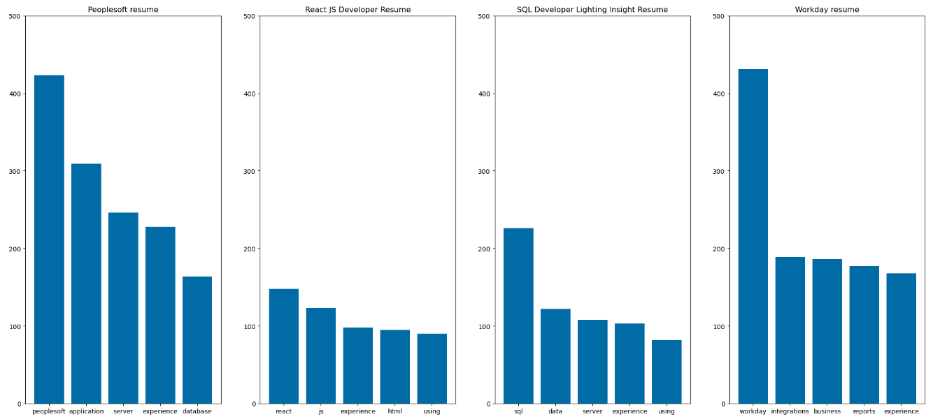
word cloud to see the Stop words from cleaned dataset
word cloud to see the category wise Stop words from dataset
PeopleSoft
React Developer
SQL Developer
Workday
Category wise Stop words Frequency

Slide 9
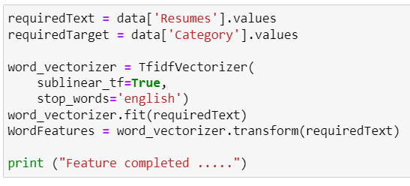
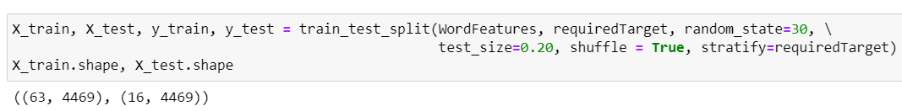
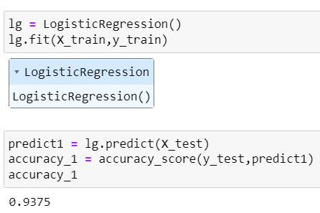
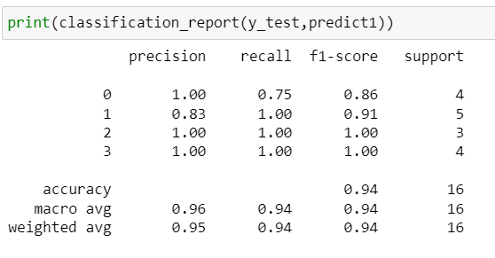
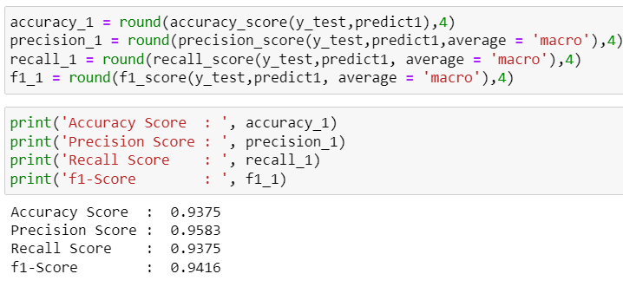
Model Building & Model Evaluation
Feature Selection
Train and test data
Logistic Regression

Slide 10
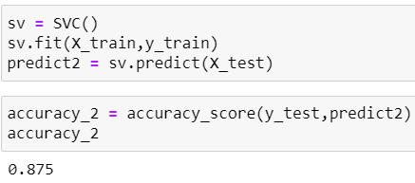
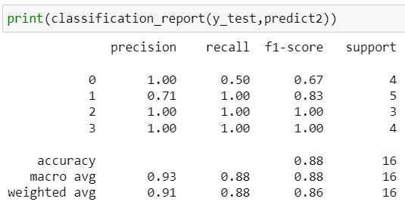
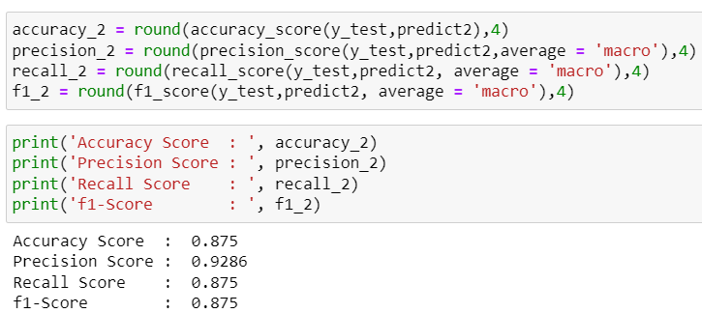
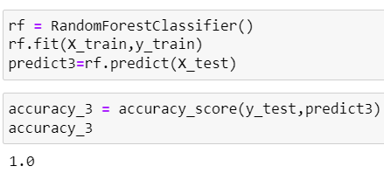
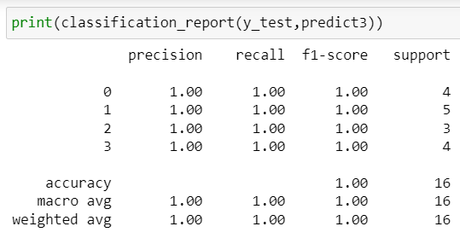
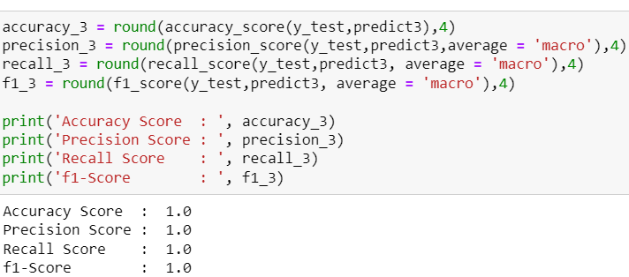
Support Vector Machine Classifier(SVC)
Random Forest Classifier

Slide 11
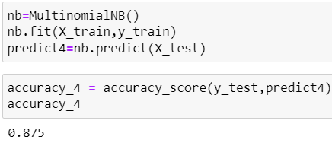
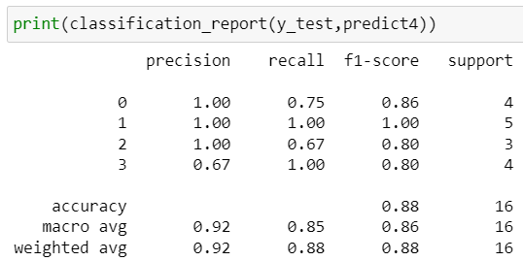
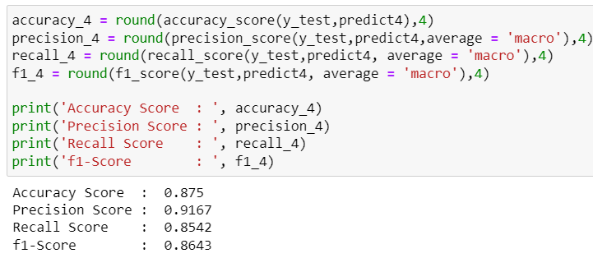
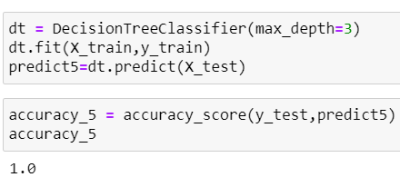
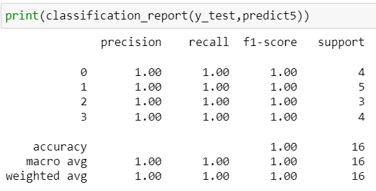
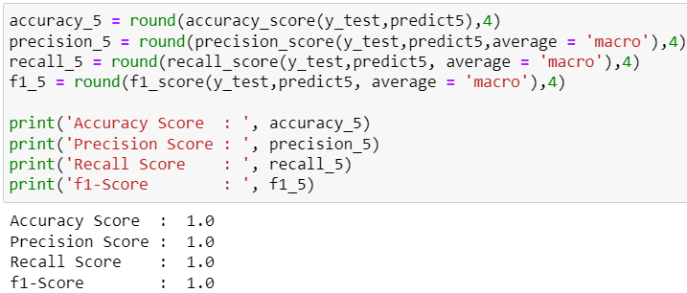
Naive-Bayes Classifier
Decision TreeClassifier

Slide 12
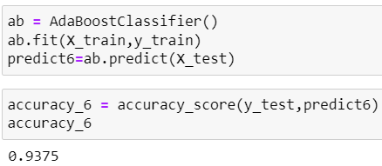
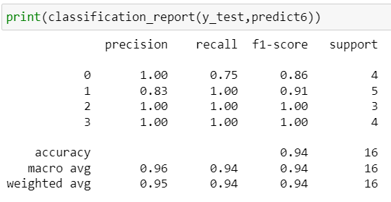
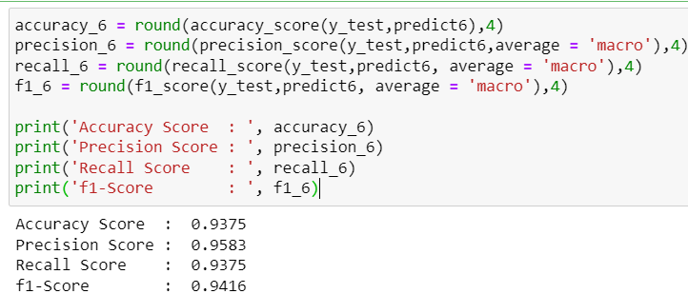
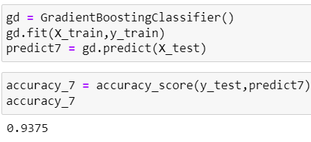
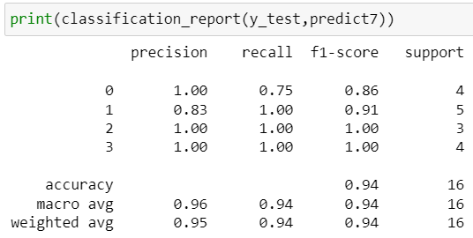
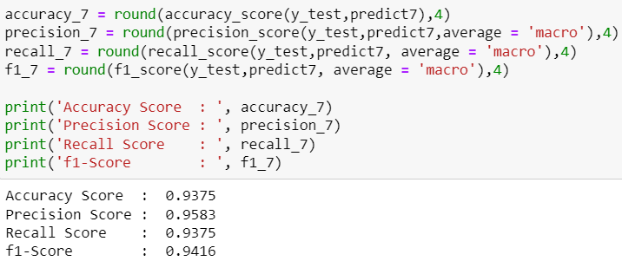
AdaBoost Classifier
Gradient Boosting Classifier

Slide 13
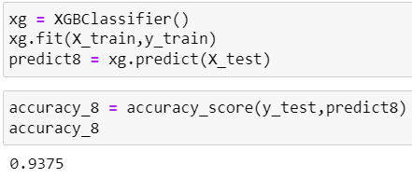
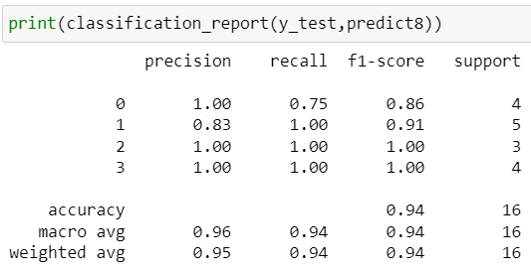
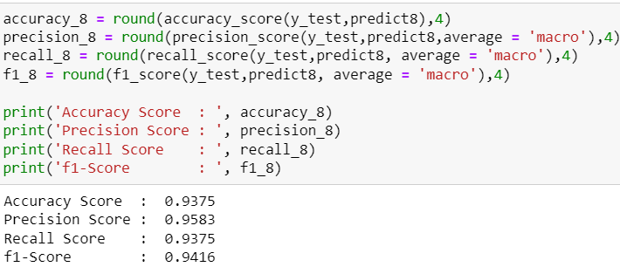
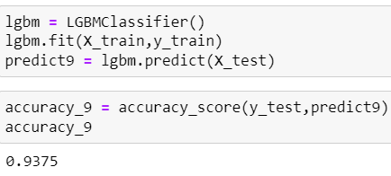
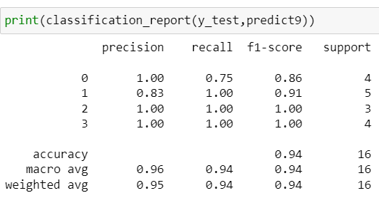
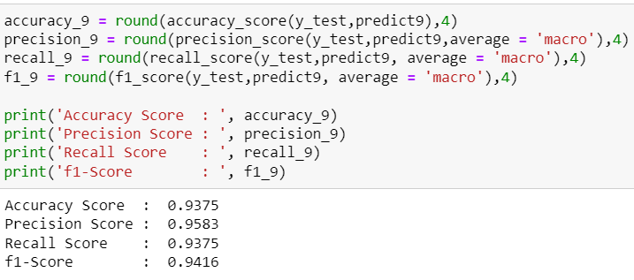
XGBoost Classifier
Light gradient boosting machine Classifier

Slide 14
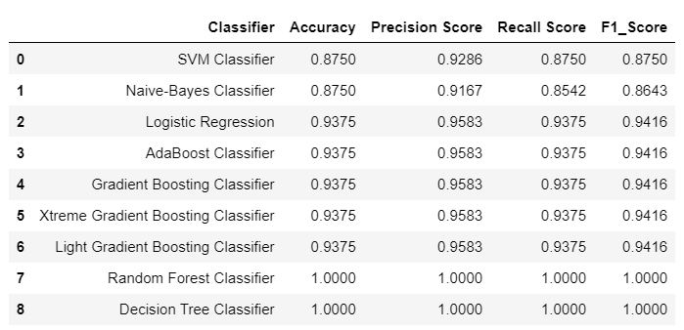
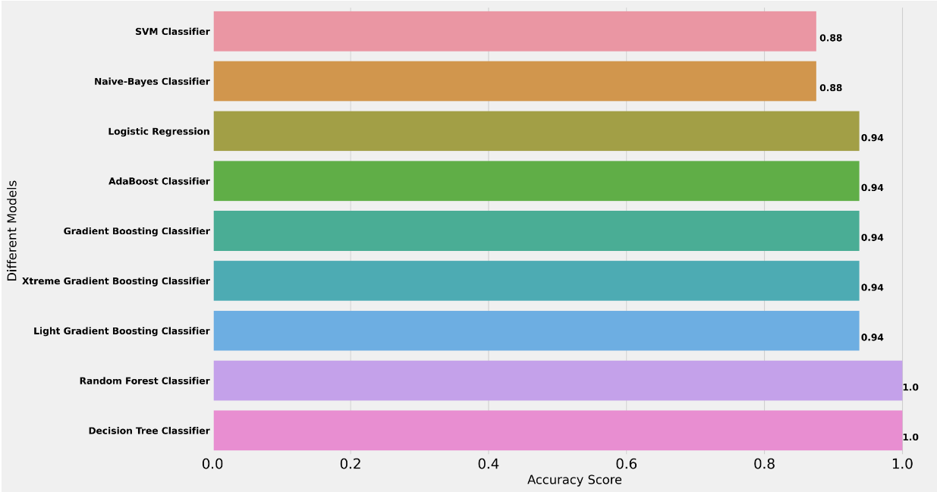
Summary of model accuracy and F1 values
As compare the relative value of different statistical models and their F1_score, we determine Decision Tree Classifier and Random forest classifier are the best fit for the observed data.

Slide 15


Deployment
Random Forest classifier algorithm has considered for the deployment.

Slide 16
Challenges Faced
Loading Multiple files and to made as one:
It is the first challenge we faced. As well as the files format and classification also different.
We over came this issue by using for loop we loaded the data as per classification and then merged all the data. And my group members also sort out the different solution for this problem we learned about new things over here.
2. Deployment:
In the deployment part we have two stages one is writing the code for deployment and second one is deploying that code by stream lit. These are the two major part for the assessing the our model is working properly.
We overcome these two major part of work with references, the references given us a brief knowledge about the creating interface and then loading the data then giving the output. We all are well defined in that code to get the best output in the interface. Then second challenge is not that much difficult but we learned it in a simple way to create a interface by using stream lit with our mentor.

Slide 17


